Slide 1
Meet your brain
In Introduction to Neuroscience for Coaches

Slide 2
Today’s roadmap
Brain basics and their ramifications
How neuroscience might be applied in coaching
Overview for Further Study
Discussion
Notes:
Outline for the presentation:
Brain basics and their ramification
Common Coaching Challenges
How neuroscience can be applied in your approach

Slide 3
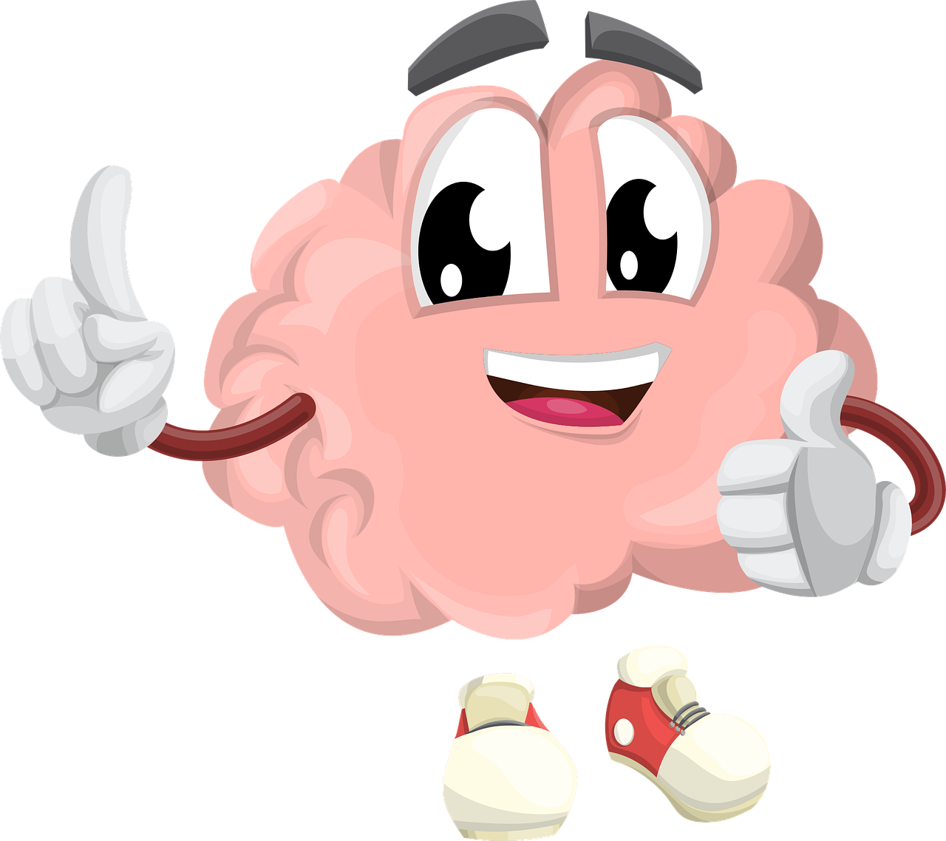
Brain basics
Brain’s number one goal is our survival
In support of No. 1 brain seeks to conserve energy
(Brain weighs 2% of body mass and uses 20% of its energy)
Our brains change every day. We can re-wire and grow our brains at any age-neuroplasticity
Notes:
Brain doesn’t care if we succeed, reach our goals, achieve our dreams. It cares only for our survival.
Because food sources were scarce and inconsistent, the brain learned to conserve energy
The last fifty years of neuroscience has shown the brain is not a static organ with sections dedicated to one function but rather a constantly changing and adapting organ thanks to neuroplasticity. This is good news for clients (and ourselves)

Slide 4
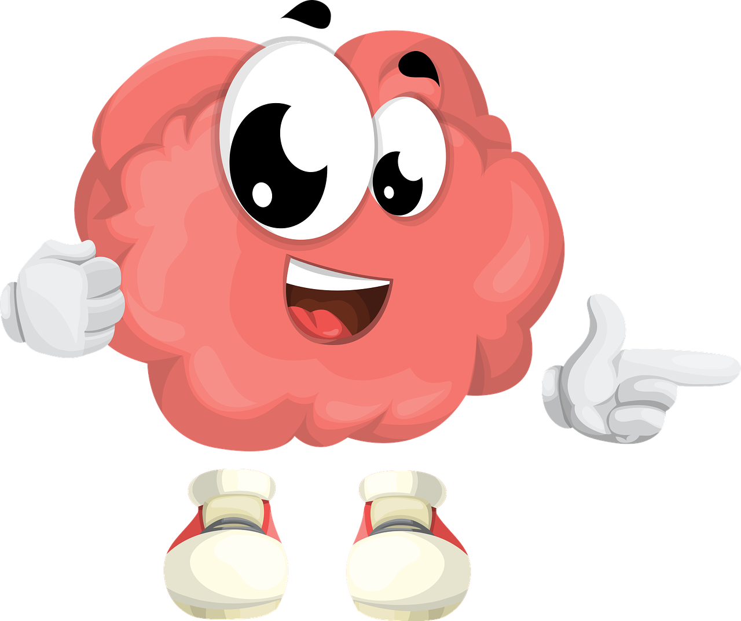
Ramifications
Brain defaults to fear setting-fear increased likelihood of survival. Survivors reproduced.
Brain is a predicting machine. Applies past learning to current situations and predicts future outcomes.
To conserve energy, brain develops habits-consciously and unconsciously.
The brain responds to perceived and actual threats the same way.
The brain cares more about what you do than who you are.
Don’t believe everything you think.
Notes:
We are descended from fearful people because fearful people survived to reproduce and those who took chances had lower survival rates. Fear was a positive adaptation.
Brain has a negativity bias-among given scenarios, focuses on the negative one.
-brain defaults to the worse case scenario and amplifies loss. It hurst more to lose $20 than it feels good to win $200.
Brain places high value on the familiar even if it no longer works for you or there are better choices.
With mindfulness, we can re-wire our brain, develop new habits and new responses.
The question isn’t do our brains change. The question is are we directing the change toward our goals.
Brain cannot multi-task. We are serial single-taskers, switching between tasks in ways that seem like multi-tasking but aren’t.

Slide 5
You can choose courage, or you can choose comfort,
but you can’t choose both.
-Brene Brown
Notes:
How might this quote impact your clients and coaching approach?

Slide 6
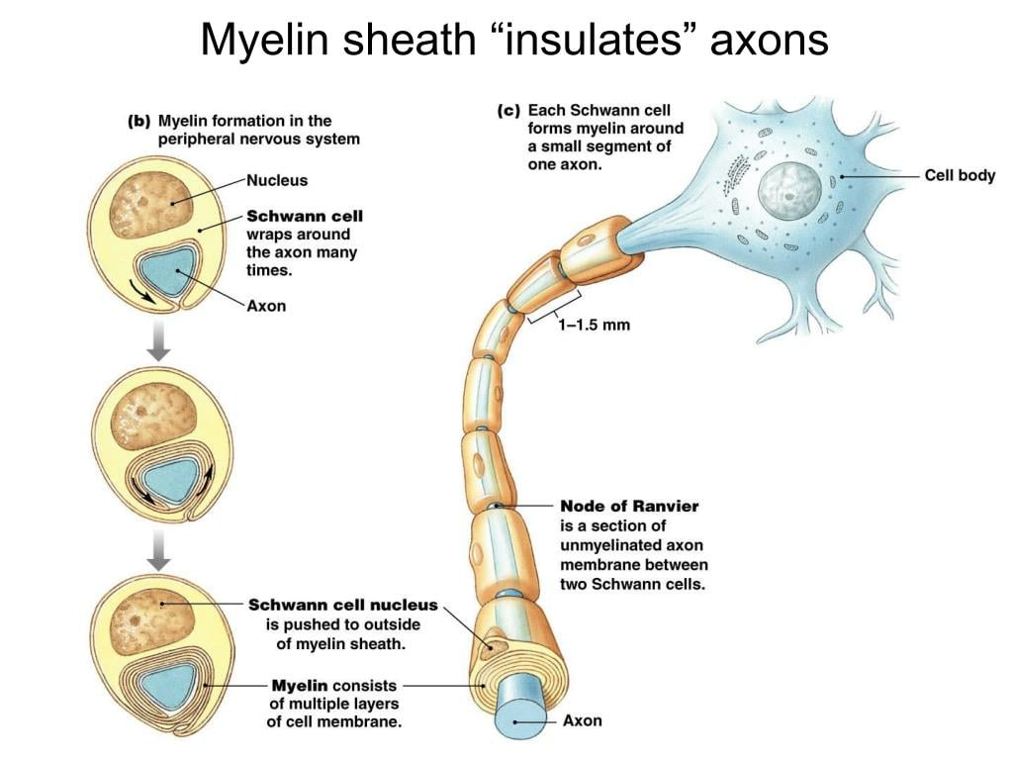
Brain Function
When a neural pathway is repeatedly used, brain recognizes its importance and strengthens it by adding to the myelin sheath around the neuron.
Thicker = The faster the nerve fires
Notes:
Repeatedly used as in habits-both habits of action AND habits of thought!

Slide 7
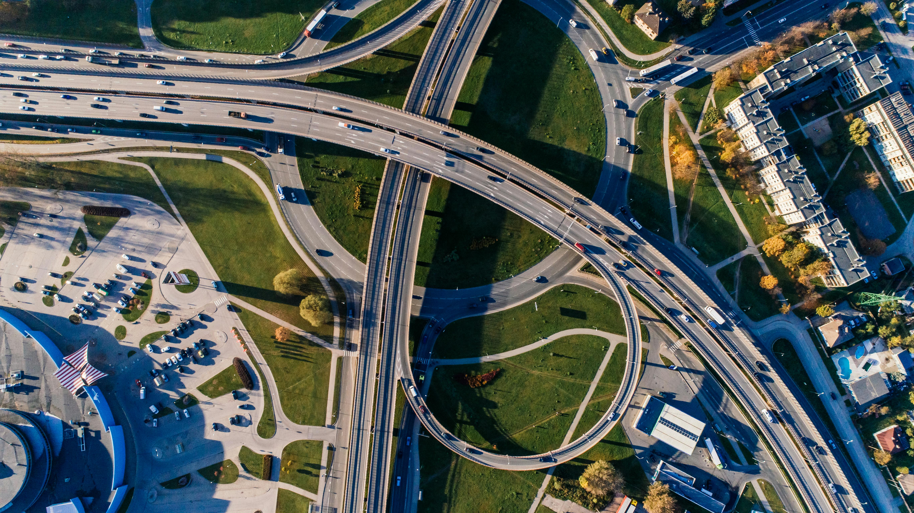
Brain Function
When a neural pathway is repeatedly used, brain recognizes its importance and strengthens it by adding to the myelin sheath around the neuron.
Thicker=Faster nerve fires
Increasing use of the pathway
(Positive emotions built on dirt roads)
(Negative emotions built on superhighways)
We can switch this (more on that, later)

Slide 8
repeatedly
We are what we do. Excellence, then, is not an act but a habit.
-Will Durant, 20th Century Philosopher

Slide 9
Coaching Insight O.A.R.S. Approach
Motivational Interviewing
Key to Client’s transformational change
O-Open-ended questions
A-Affirm what clients says in response. “Its okay to feel what you’re feeling.”
R-Reflect/Restate what they said.
Rather than: “What I hear you saying.”
State one thing you heard:
“That’s interesting you felt____ and the thing that irritated you most was_____.”
S-Summarizing multiple points.
“Let me back up. You said you were proud of your work until your boss commented and then you felt down.”
Then repeat back to O.

Slide 10
Coaching Insight O.A.R.S. Approach
On-going Coaching Agreement
Motivational Interviewing
Key to Client’s transformational change
O-Open-ended questions
A-Affirm what clients says in response. “Its okay to feel what you’re feeling.”
R-Reflect/Restate what they said.
Rather than: “What I hear you saying.”
State one thing you heard:
“That’s interesting you felt____ and the thing that irritated you most was_____.”
S-Summarizing multiple points.
“Let me back up. You said you were proud of your work until your boss commented and then you felt down.”
Then repeat back to O.
What would you
like to talk about?
What do you hope
to take away?
Are we still talking about
what matters?
What are possible
next steps?
Who can support you
and hold you accountable?

Slide 11
Mindfulness Increases prefrontal lobe, decreases amygdala
Fight, Flight, Freeze
Stressful Situation
Response
Notes:
Mindfulness defined=paying attention on purpose, in the present moment, and nonjudgmentally.
When you have a thought, take an observer’s perspective and watch. Rather than getting caught up in emotional response take time to get curious about the physical response.

Slide 12
Mindfulness Increases prefrontal lobe, decreases amygdala
Fight, Flight, Freeze
Mindfulness
Buffer
Stressful Situation
Response
Curiosity, Creativity, Problem-solving
Mindfulness allows decisions to be made from a place of values and intention rather
than a reaction to stimuli. We become more fully human, proactive rather than reactive.
Notes:
Mindfulness defined=paying attention on purpose, in the present moment, and nonjudgmentally.
When you have a thought, take an observer’s perspective and watch. Rather than getting caught up in emotional response take time to get curious about the physical response.

Slide 13
The curious paradox is that when I accept myself
just as I am, then I can change.
Carl Rogers, Founder of Humanistic Psychology
Notes:
How might this quote impact your clients and coaching approach?

Slide 14
Relationships, Part I
VS
We treat each other like a PDF. Better to think of each other as an editable Word Doc. Our brains are in flux with unlimited potential.
They’re having a bad day vs They’re a bad person.
Adding ‘er’ to description condemns the person to that descriptor-complainer, whiner, etc.
When we do this, we elicit the very behavior we have labelled them as having!
Notes:
We treat each other as though we are static and use cultural language that is static. This snap-shot is easy for the brain to do.
The positive side is also true-telling someone they are a sharer, supporter, encourager reinforces that image of them and elicits that behavior.

Slide 15
Relationships, Part II
Learning
Prediction
We meet someone. Our brains are open to learning about them and begin
to lock them into a certain type/behavior. Size them up and start predicting.
Notes:
Brain believes it knows how people will behave and stops learning about them.
Thinking becomes fixed. Brain prides itself in its ability to predict.
We stop considering that we may be wrong about the person-stop taking in new data and learning.

Slide 16
Relationships, Part II
Learning
Prediction
We meet someone. Our brains are open to learning about them and begin
to lock them into a certain type/behavior. Size them up and start predicting.
Notes:
Brain believes it knows how people will behave and stops learning about them.
Thinking becomes fixed. Brain prides itself in its ability to predict.
We stop considering that we may be wrong about the person-stop taking in new data and learning.

Slide 17
Prediction Loops
Learning
Learning
Mindfulness
Prediction
Prediction
Mindfulness allows us to maintain an attitude of learning and curiosity.
Notes:
Brain believes it knows how people will behave and stops learning about them.
Thinking becomes fixed. Brain prides itself in its ability to predict.
We stop considering that we may be wrong about the person-stop taking in new data and learning.

Slide 18
Attention is the rarest and purest form of generosity.
Simone Weil, 20th Century French philosopher
(giving someone your attention is the best way to operationalize love)

Slide 19
Coaching insight
Nonjudgmental awareness-invite client to consider alternative perspectives
Curiosity leads to learning.
Meta cognition-thinking above your thinking
Notes:
How to engage repeat clients with a sense you’ve never met?

Slide 20
The Action loop (How to make hope a habit)
The Action Loop
Inspiration
Motivation
Action
Notes:
We usually think we start with inspiration, a thought or an idea that leads to motivation and then action which inspires us to continue.
But what happens is we say or think, “I don’t feel like doing…..” Inspiration is based on feelings and those are harder to control.
This gets into the rider and the elephant and the two brain perspective of immediate and long term reward
Instead focus on what we can control-Action.

Slide 21
The Action loop
Wishing
Hoping
VS
Believing the future
will be better
Believing the future
will be better
AND
Taking Action
Thinking
Doing
Notes:
This gets into WOOP!-wish, outcome, obstacle, plan-mental contrasting

Slide 22
The Action loop (How to make hope a habit)
The Action Loop
Action
Inspiration
Motivation
Start here!
Notes:
Self-motivation is a learnable skill. Hard nosed, tactical and strategic decision to act on what I can control.
Help clients define a goal then identify what they can control through their actions to achieve it.

Slide 23
Action isn’t just the effect of motivation, it’s also the cause of it.
Mark Manson

Slide 24
Brain’s Two Goals
Survival/Conserve Energy
Actions
Emotions
Habits By Default
Habits by Design
Happiness
Fear
Motivation
Willpower
When
Know Thyself
Energy Level
Rider and the Elephant
WOOP!
Mini Habits
Productivity
Positivity Bias
Loops
Worry
Habit
Negative Reinforcement Trap
Thinking Distortions
Logic of Identity
Stress
Chronic
Temporary
Hope
Action Loop
Negativity Bias
Joy’s Cousins
Mindfulness
Prediction Loops
FLOW
Traps

Slide 25
Discussion/Questions
What’s one take away for you?
What’s one area you’d like to learn more about?

Slide 26
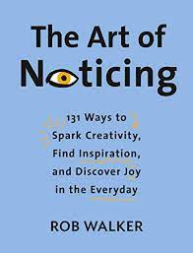
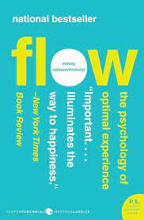
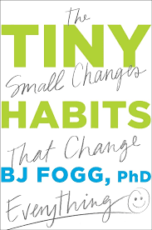
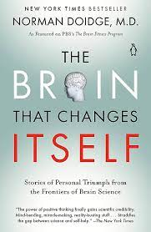
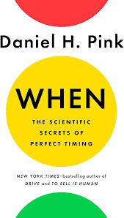
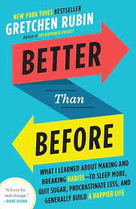
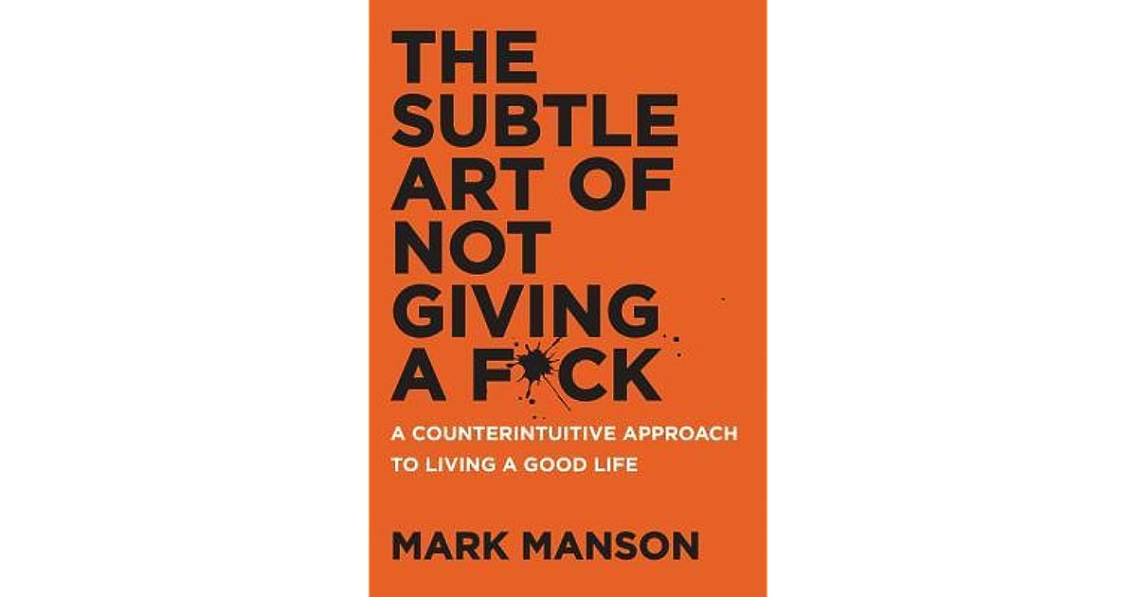
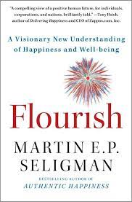
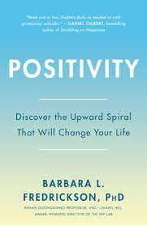
Bibliography
Go for a walk

